Slide 1







RECOMMENDER SYSTEM
GOVIND MOHAN SHAH
AP22110011511

Slide 2


INTRODUCTION
WHAT IT IS?
A RECOMMENDER SYSTEM IS A TOOL WIDELY USED BY MAJOR BRANDS TO ENHANCE USER ENGAGEMENT. IT PROVIDES PERSONALIZED RECOMMENDATIONS BASED ON AN INDIVIDUAL'S PREFERENCES OR THE PREFERENCES OF USERS WITH SIMILAR INTERESTS AND BEHAVIORS.

Slide 3




TYPES
CONTENT BASED
COLLABRATIVE BASED
filtering methods are based on the description of a product and a profile of the user’s preferred choices. In this recommendation system, products are described using keywords, and a user profile is built to express the kind of item this user likes.
filtering method is based on gathering and analyzing data on user’s behavior. This includes the user’s online activities and predicting what they will like based on the similarity with other users.

Slide 4

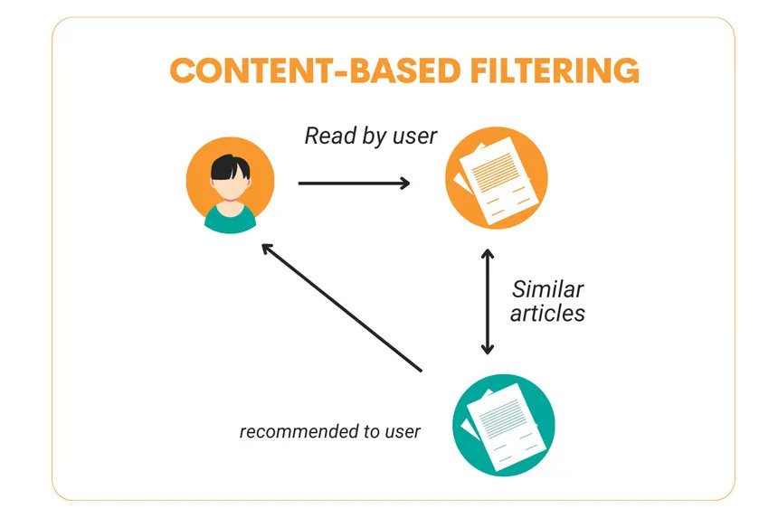

EXAMPLE OF CONTENT BASED
As discussed previously, this method relies on the content you've previously viewed or liked. Based on this history, similar genres or features will be recommended to you.

Slide 5

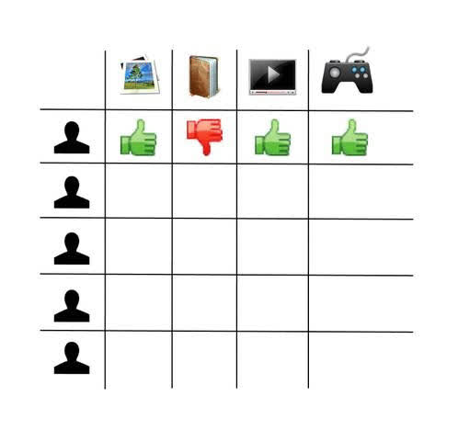


EXAMPLE OF
COLLABRATIVE BASED
In a collaborative recommendation system, recommendations are based on the preferences of similar users. Content liked or viewed by users with tastes like yours will be suggested to you.

Slide 6
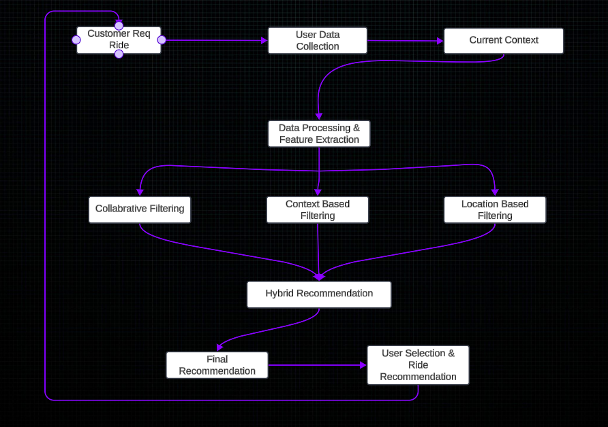
EXAMPLE OF REALTIME UBER

Slide 7


CONCLUSION
SUMMARIZING THE MAJOR CONTEXT OF THIS PRESENTATION
Recommender system is a powerful tool employed by many companies to enhance their marketing strategies by anticipating and meeting user needs and preferences. By analyzing user behavior, past interactions, and relevant patterns, these systems can provide personalized recommendations, improving user engagement and satisfaction.Two Types of recommendation System:
Content Based -> Analyzing the specific features of items (such as genre, tags, or keywords) and user preferences to suggest similar items, which works well for new users without extensive data on past behavior.
Collabrative Based -> Focus on user interactions and feedback, leveraging the behavior of similar users to recommend items, making it highly effective for capturing evolving trends and preferences within a user community.

Slide 8


THANK YOU

